Slide 1

APPLICATION OF DATA MINING AND COMMERCIAL DATA MINING TOOLS
Presented By:
Jordan .R. Kharkhrang
Sheakha B.T. War Nongbri

Slide 2
Content
Application of Data Mining
Marketing
Finance
Manufacturing
Health Care
Commercial Tools of Data Mining
User Interface
Application Programming Interface
Future Direction

Slide 3
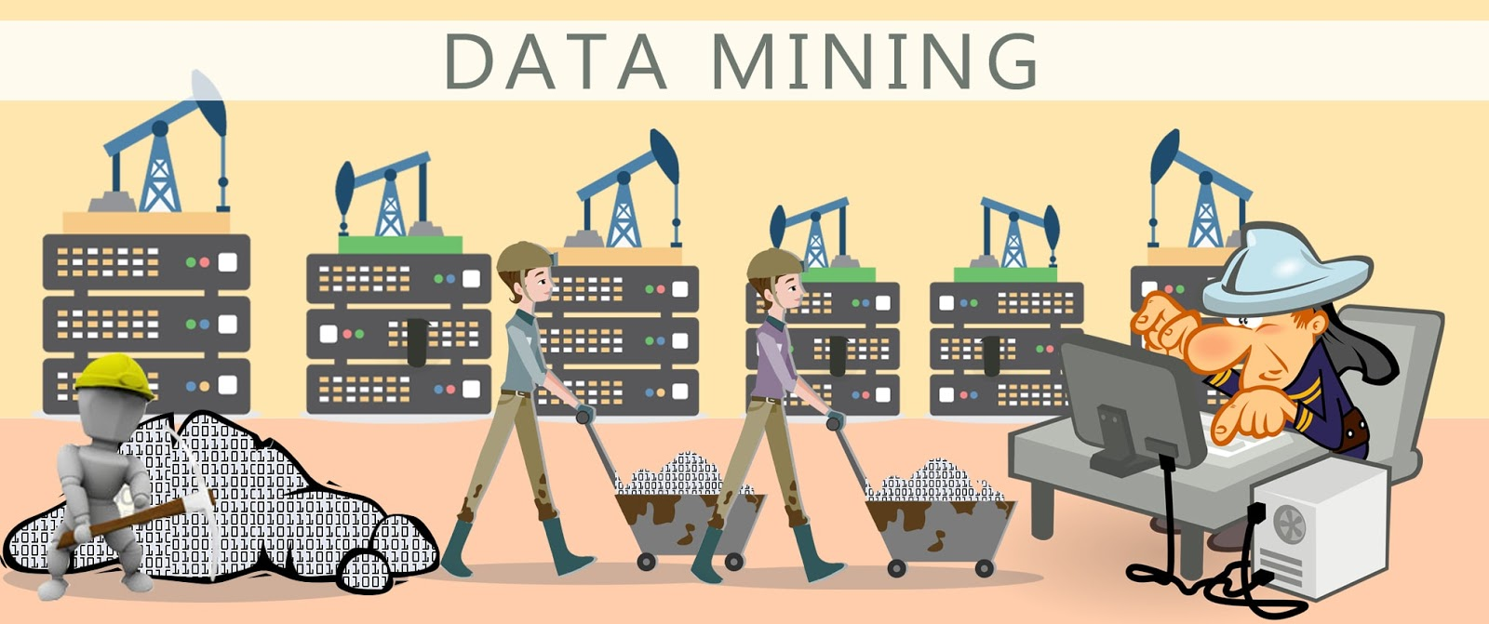
Data Mining is defined as the procedure of extracting information from huge sets of data
There is a huge amount of data available
It is necessary to analyze this huge amount of data and extract useful information from it
The Overall goal of the Data Mining process is to extract information from a data set and transform it into an understandable structure for further use.

Slide 4
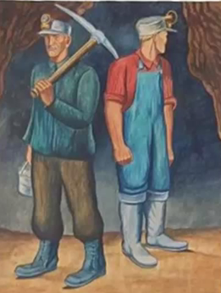
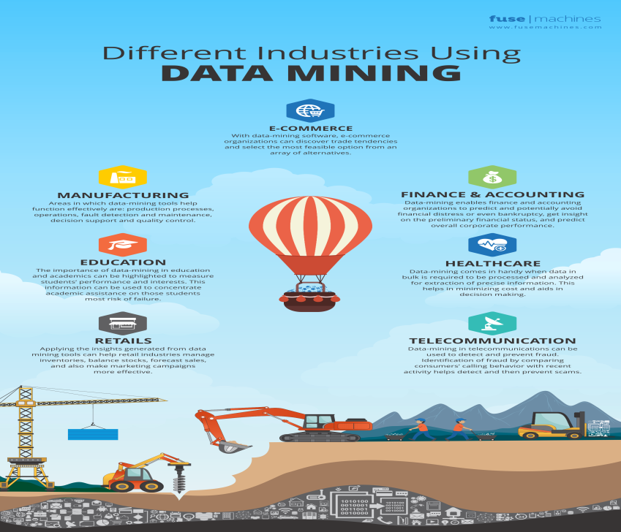
Data mining application
Data mining technologies can be applied to a large variety of decision-making contexts in business.
In particular, areas of significant payoffs are expected to include the following:
Marketing
Finance
Manufacturing
Health Care

Slide 5

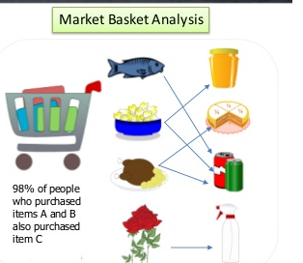
DATA MINING APPLICATION
Marketing:
Applications include analysis of consumer
behaviour based on buying patterns
Determination of marketing strategies including advertising, store location and targeted mailing
Segmentation of customers, stores, or products
Design of catalogs, store layouts, and advertising campaigns.
Retail companies use data mining to identify customer’s behaviour buying patterns.

Slide 6
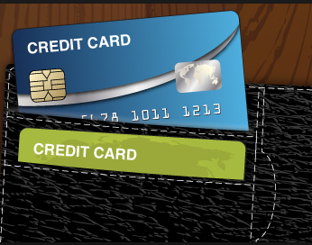

DATA MINING APPLICATION
Financial Data Analysis
The financial data in banking and financial industry is generally reliable and of high quality which facilitates systematic data analysis and data mining. Some of the typical cases are as follows −
Design and construction of data warehouses for multidimensional data analysis and data mining.
Loan payment prediction and customer credit policy analysis.
Classification and clustering of customers for targeted marketing.
Detection of money laundering and other financial crimes.

Slide 7


fraud detection:
Data mining is also used in the fields of credit card services and telecommunication to detect frauds
In fraud telephone calls, it helps to find the destination of the call, duration of the call, time of the day or week, etc
It also analyzes the patterns that deviate from expected norms

Slide 8


DATA MINING APPLICATION
Manufacturing
Applications involve optimization of resources like machines, manpower, and materials
Optimal design of manufacturing processes, shop-floor layouts, and product design, such as for automobiles based on customer requirements
Data mining tools can be very useful to discover patterns in complex manufacturing process.
Data mining can be used in system-level designing to extract the relationships between product architecture, product portfolio, and customer needs data.
It can also be used to predict the product development span time, cost, and dependencies among other tasks

Slide 9
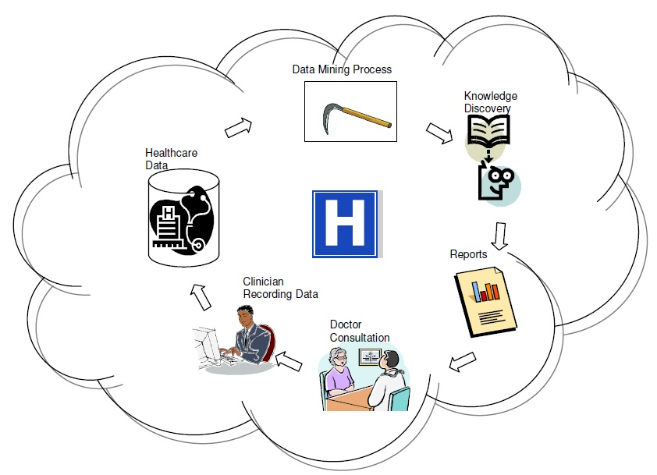
Health Care
Applications include discovery of patterns in radiological images, analysis of microarray (gene-chip) experimental data to cluster genes and to relate to symptoms or diseases, analysis of side effects of drugs and effectiveness of certain treatments, optimization of processes within a hospital, and the relationship of patient wellness data with doctor qualifications
Data mining enables to characterize patient activities to see incoming office visits.
Data mining helps identify the patterns of successful medical therapies for different illnesses

Slide 10


Insurance
Data mining is applied in insurance industry lately but brought tremendous competitive advantages to the companies who have implemented it successfully. The data mining applications in insurance industry are listed below:
Data mining is applied in claims analysis such as identifying which medical procedures are claimed together.
Data mining enables to forecasts which customers will potentially purchase new policies.
Data mining allows insurance companies to detect risky customers’ behaviour patterns.
Data mining helps detect fraudulent behaviour.

Slide 11

Telecommunication Industry
Today the telecommunication industry is one of the most emerging industries providing various services such as fax, pager, cellular phone, internet messenger, images, e-mail, web data transmission, etc

Slide 12

Data mining in telecommunication industry helps in identifying the telecommunication patterns, catch fraudulent activities, make better use of resource, and improve quality of service.
Here is the list of examples for which data mining improves telecommunication services −
Multidimensional Analysis of Telecommunication data.
Fraudulent pattern analysis.
Identification of unusual patterns.
Multidimensional association and sequential patterns analysis.
Mobile Telecommunication services.
Use of visualization tools in telecommunication data analysis.

Slide 13
Commercial Data Mining Tools
Currently, commercial data mining tools use several common techniques to extract knowledge
These include association rules, clustering, neural networks, sequencing, and statistical analysis
Other Commercial products use advanced techniques such as genetic algorithms, case based reasoning, Bayesian networks, nonlinear regression, combinatorial optimization, pattern matching, and fuzzy logic

Slide 14
Most data mining tools use the ODBC (Open Database Connectivity) interface.
ODBC is an industry standard that works with databases, it enables access to data in most of the popular database programs such as Access, Oracle, SQL Server,etc
Most of the tools work in the Microsoft Windows environment and a few work in the UNIX operating system
In general, these programs perform sequential processing in a single machine
Many of these products work in the client-server mode.
Some products incorporate parallel processing in parallel computer architectures and work as a part of online analytical processing (OLAP) tools.

Slide 15
User Interface
Most of the tools run in a graphical user interface (GUI) environment
Some products include sophisticated visualization techniques to view data and rules (for example, SGI’s MineSet), and are even able to manipulate data this way interactively
Text interfaces are rare and are more common in tools available for UNIX, such as IBM’s Intelligent Miner

Slide 16
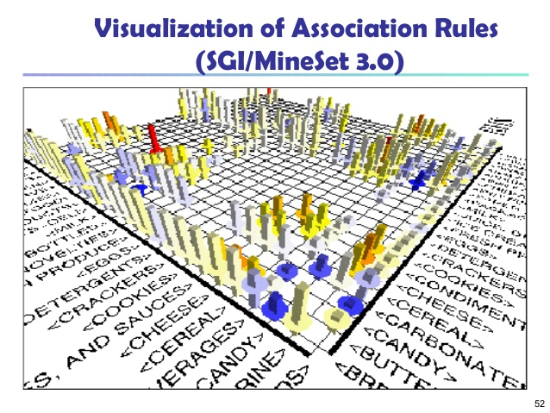
SGI MineSet

Slide 17
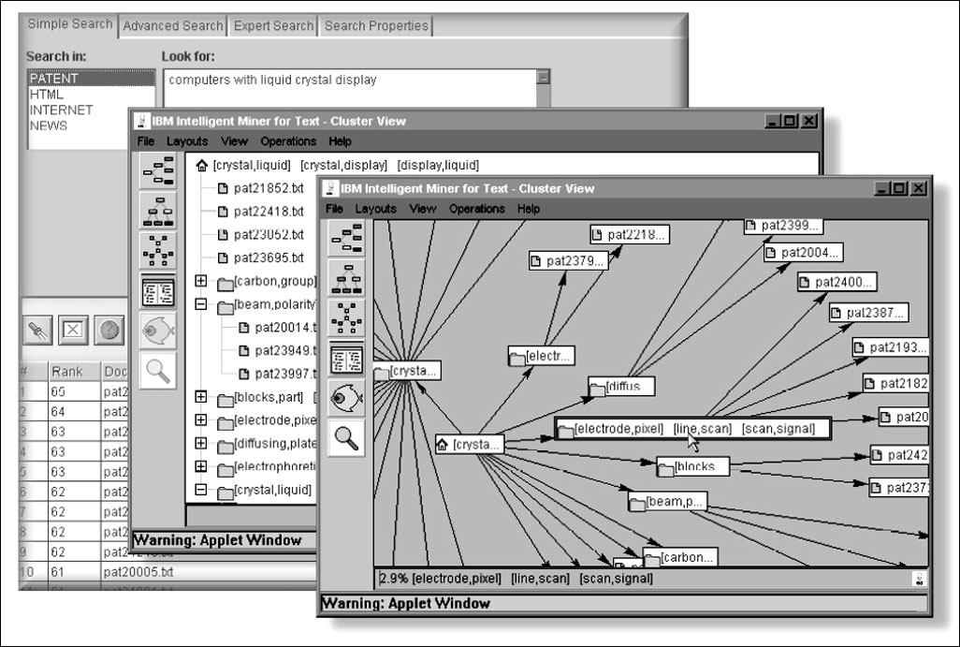
IBM’s Intelligent Miner

Slide 18
Application Programming Interface
Usually, the application programming interface (API) is an optional tool
Most products do not permit using their internal functions. However, some of them allow the application programmer to reuse their code
The most common interfaces are C libraries and Dynamic Link Libraries (DLLs)
In the Table we list 11 representative data mining tools. To date, there are almost one hundred commercial data mining products available worldwide.

Slide 19
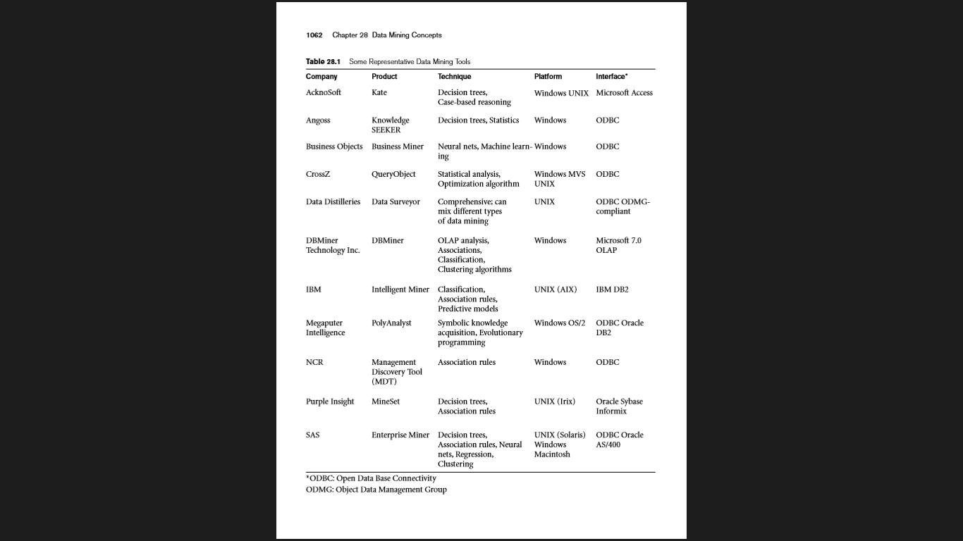

Slide 20
Future Directions
Data mining tools are continually evolving, building on ideas from the latest scientific research
Many of these tools incorporate the latest algorithms taken from artificial intelligence (AI), statistics, and optimization
Currently, fast processing is done using modern database techniques—such as distributed processing—in client-server architectures, in parallel databases, and in data warehousing
For the future, the trend is toward developing Internet capabilities more fully. Additionally, hybrid approaches will become commonplace, and processing will be done using all resources available. Processing will take advantage of both parallel and distributed computing environments

Slide 21
This shift is especially important because modern databases contain very large amounts of information
Not only are multimedia databases growing, but also image storage and retrieval are slow operations
Also, the cost of secondary storage is decreasing, so massive information storage will be feasible, even for small companies
Thus, data mining programs will have to deal with larger sets of data of more companies
Most of data mining software will use the ODBC(open database connectivity) standard to extract data from business databases; proprietary input formats can be expected to disappear
There is a definite need to include nonstandard data, including images and other multimedia data, as source data for data mining.

Slide 22
References
FUNDAMENTALSOF Database Systems SIXTHEDITION
Ramez Elmasri Department of Computer Science and Engineering The University of Texas at Arlington
Shamkant B. Navathe College of Computing Georgia Institute of Technology
https://www.tutorialspoint.com/data_mining/dm_overview.htm
http://delab.csd.auth.gr/papers/ICESA04km.pdf
https://www.tutorialspoint.com/data_mining/dm_applications_trends.htm

